Slide 1

Fields Experiments in Policy Evaluation: The Case of Freedom of Information Laws in Belgium
TRANSACT
(Transparency in Action)
Giovanni Esposito
Université libre de Bruxelles
SISP Standing Group on Administrations and Public Policy
14/10/2025

Slide 2












TRANSACT: civil society and academia

Slide 3

Outline of the presentation
Research Context and Conceptual Foundations
Transparency and FOI laws
The implementation gap and evaluation questions
Field Experiments on FOI Implementation
Application to Belgium and Experimental Protocol
Treatments and randomization
Data collection and coding procedures
Key Results and Discussion
Main Takeaways and Next Steps in TRANSACT

Slide 4

Government transparency
Government transparency refers to the practice of making the government's actions, decisions, and governance processes accessible to the public
Transparency strengthens:
Democratic institutions
Reduction of information asymmetries between citizens (principals) and public officials (agents), improving accountability and trust in government (e.g. Lupia & McCubbins (1998)
Market institutions
In welfare economics, perfect information enables optimal decisions and efficient resource allocation, leading to a stable market equilibrium (e.g. Smith, 1776; Walras, 1874; Pareto, 1896)
Notes:
In welfare economics, this model underpins the First Fundamental Theorem of Welfare Economics, which states that: Under perfect competition and complete information, markets lead to efficient outcomes.
Adam Smith (1776) – The Wealth of Nations
Léon Walras (1874) – Éléments d’économie politique pure
Vilfredo Pareto (1896, 1906) – Manuale di economia politica
Lupia, A., & McCubbins, M. D. (1998). The democratic dilemma: Can citizens learn what they need to know?. Cambridge University Press.

Slide 5
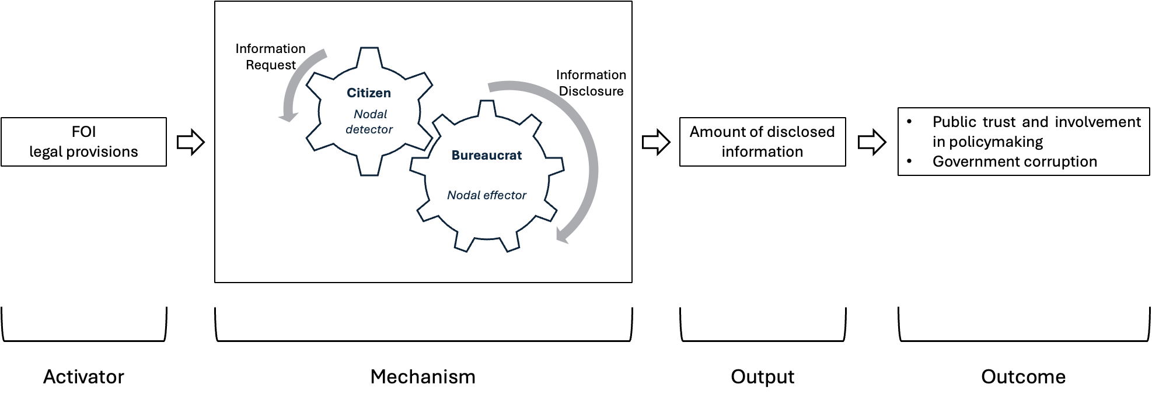
FOI laws as policy tools for information disclosure
Procedural tools that grant citizens the right to access government-held information and require public officials to disclose it (Howlett, 2009)
Policy outcomes : lower corruption (e.g. Žuffová, 2020) , better public trust and participation (Hood & Heald, 2006; Rodriguez et al., 2023)
Unpacking the functioning of policy tools by examining the relationship between activators, mechanisms, outputs, and outcomes (Capano & Howlett, 2021).

Slide 6
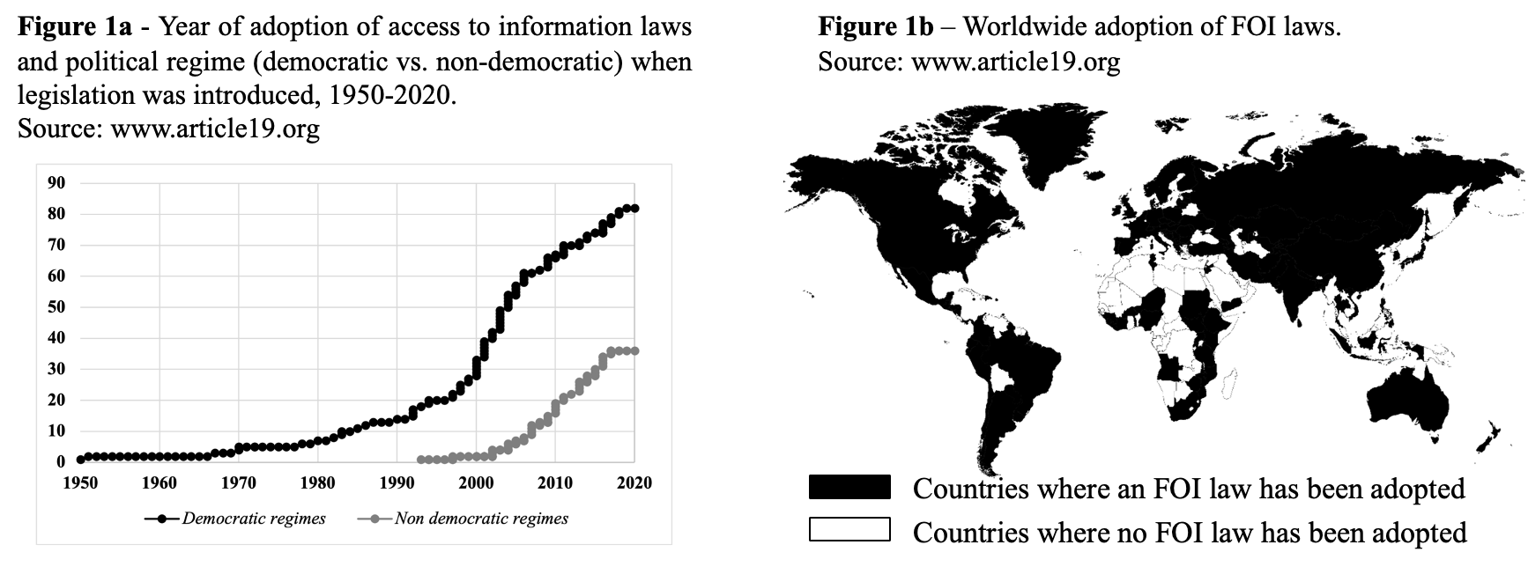
Adoption of FOI laws
Governments frequently fail to comply with their own FOI legislation when responding to citizen requests, leading to low de facto compliance rates (Michener et al., 2021)
Notes:
Why do FOI laws, despite widespread formal adoption, fail in practice to deliver on their promise of transparency?

Slide 7
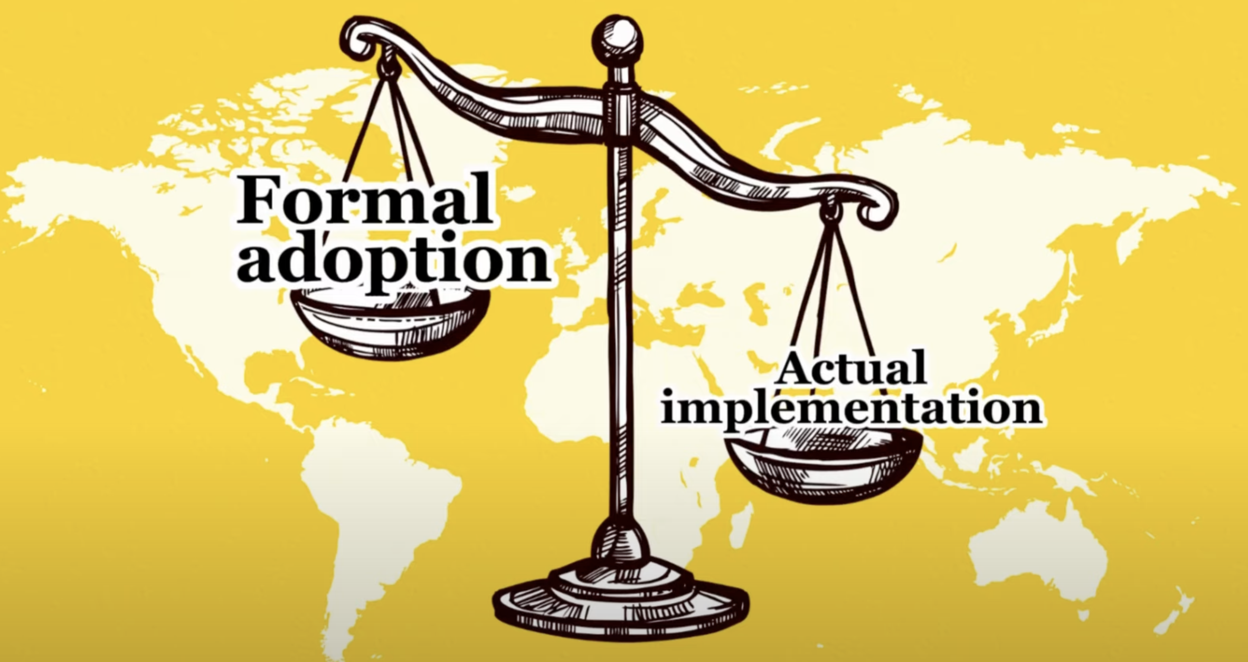
Implementation gap
”Adopting regulation (de jure compliance) may not equate to responsiveness to citizens in practice (de facto compliance)” (Michener and Nichter, 2022: 39)

Slide 8
Seizing the implementation gap
The implementation gap emerges in practice, at the point of interaction between citizens requesting information and public officers responding
Evaluation question : To what extent do public officers disclose the information requested by citizens?
To capture it, we need real-life data:
FOI open-data platforms documenting actual exchanges between citizens and PA (e.g. Trautendorfer et al., 2024)
Field experiments activating citizen–PA interactions (e.g. Cuillier, 2010)
Bureaucratic
Discrestion
(e.g. Ejiogu et al., 2019; Wilson, 2015)

Slide 9
Seizing the implementation gap
The implementation gap emerges in practice, at the point of interaction between citizens requesting information and public officers responding
Evaluation question : To what extent do public officers disclose the information requested by citizens?
To capture it, we need real-life data:
FOI open-data platforms documenting actual exchanges between citizens and PA (e.g. Trautendorfer et al., 2024)
Field experiments activating citizen–PA interactions (e.g. Cuillier, 2010)
Field experiment
Submitting FOI requests to public administrations, observing their responses, and systematically modifying content to gauge their impact
Bureaucratic
discrestion

Slide 10
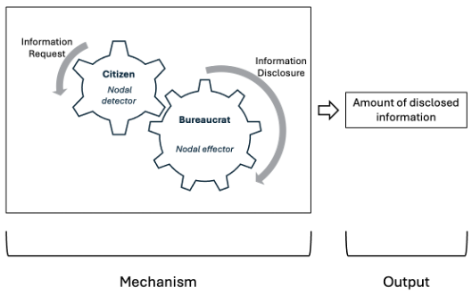
Field expetiments and FOI implementation
 | KEY LITERATURE
Request | Tone of communication in request text (e.g. Cuillier, 2010; Trautendofer et al., 2024)
 | Invoking right in request text (e.g. Worthy et al. 2017, Spac et al. 2018, Grimmelikhuijsen et al. 2018)
Requester | Requesters’ social status (e.g. Michener and Rodrigues, 2015)
 | PA responsiveness to FOI requests varies across jurisdictional contexts (e.g. Cicatiello et al. 2024, Wagner 2021)

Slide 11
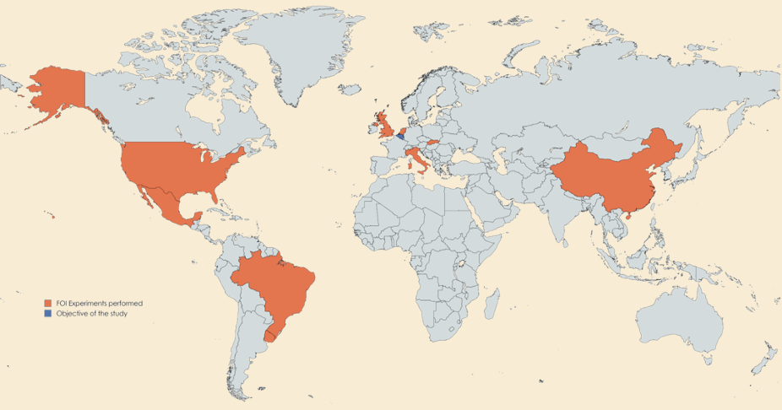
Field experiments and FOI implementation
Existing field experiments:
United States
Brazil
England
the Netherlands
Slovakia
Mexico
Italy
China
TRANSACT:
Belgium (2023)
Switzerland (2025)
Romania (2026)
South Africa (2026)

Slide 12

FOI laws in Belgium
Adopted in 1994
Belgian constitution (art. 32)
Regional laws transpose contitutional art. 32
Individuals can submit written requests (including via e-mail) for documents held by PA
No need to demostrate a specifc interest
PA response within maximum 45 days

Slide 13

A citizen science project
Citizen science and collaboration with civil society (Göbel et al., 2021)
Leverages local knowledge to ensure contextual relevance
Prevents deception
Co-designs, collects, and interprets data jointly with researchers
Enhances impact, as research findings feed directly into advocacy work and policy dialogue

Slide 14

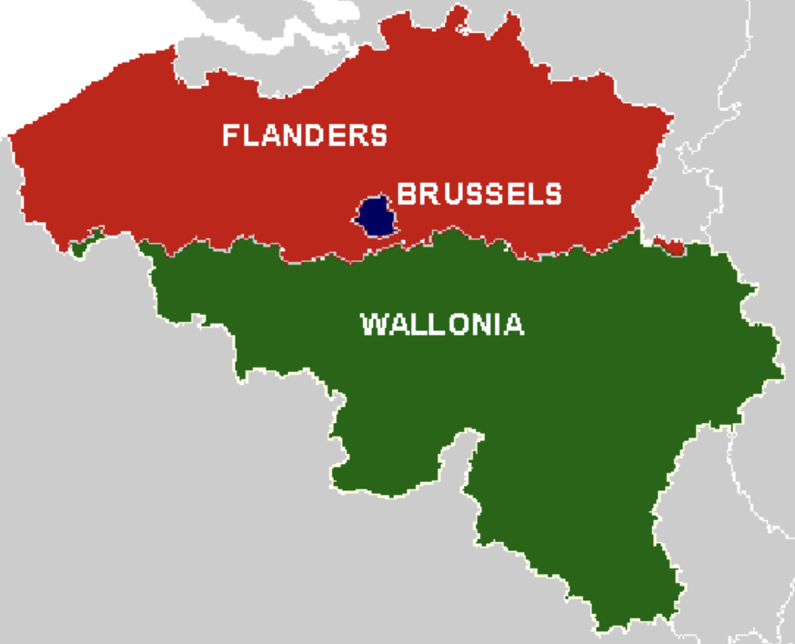
Evaluation questions and field experiment in Belgium
Evaluation questions:
Do Belgian municipalities respond to FOI requests and provide requested information?
Do they discriminate among requesters?
Different requesters’ profiles
Common
citizen
University
Prof.
CSO
member
Experimental objectives:
how municipalities react to different types of requesters — ordinary citizens, academics, and CSO member
to test whether explicitly mentioning FOI law strengthens or alters these effects
Municipal administrations
(n= 581)

Slide 15
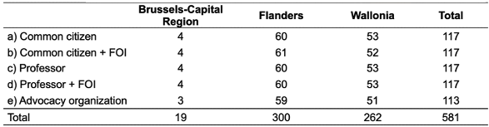
Experimental plan
Experimental groups
Control group
Common Citizen (baseline, no FOI mention)
Treatment groups
Citizen + FOI mention → effect of invoking rights
Professor → effect of status
Professor + FOI mention → combined effect
Advocacy Organization (Transparencia.be) → civil society profile
Randomisation
Municipalities randomly assigned to five treatment groups
Stratified randomization based on:
Region: Flanders, Wallonia, Brussels-Capital (captures linguistic, cultural & institutional differences)
Size: <12,000 • 12,000–50,000 • >50,000 (proxy for administrative capacity)

Slide 16

Document for FOI request
Transparencia.be :
Standard document available in all Belgian municipalities
Enhance democratic processes and hold the council meeting accountable to citizens
La note explicative des points de l’ordre du jour du dernier conseil communal et des annexes
(tr. “Agenda of the last municipal council meeting with its annexes”)

Slide 17
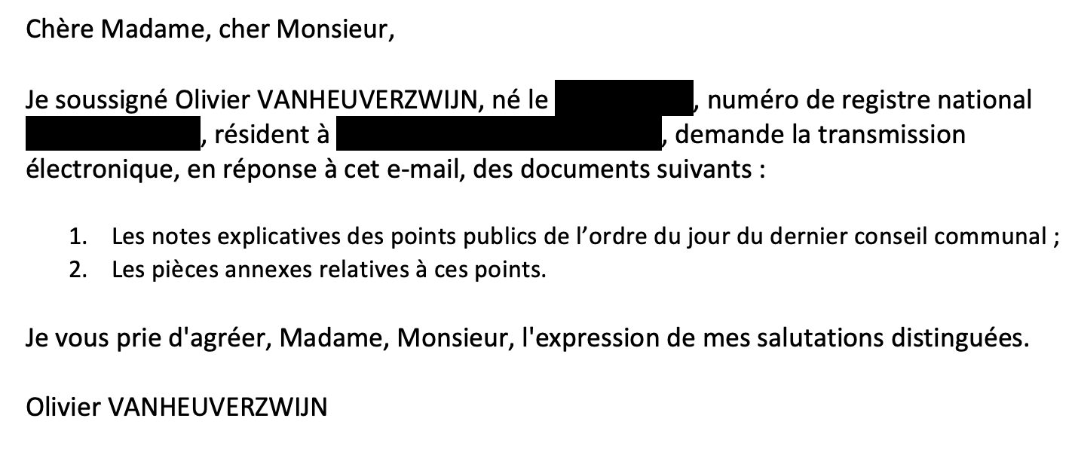
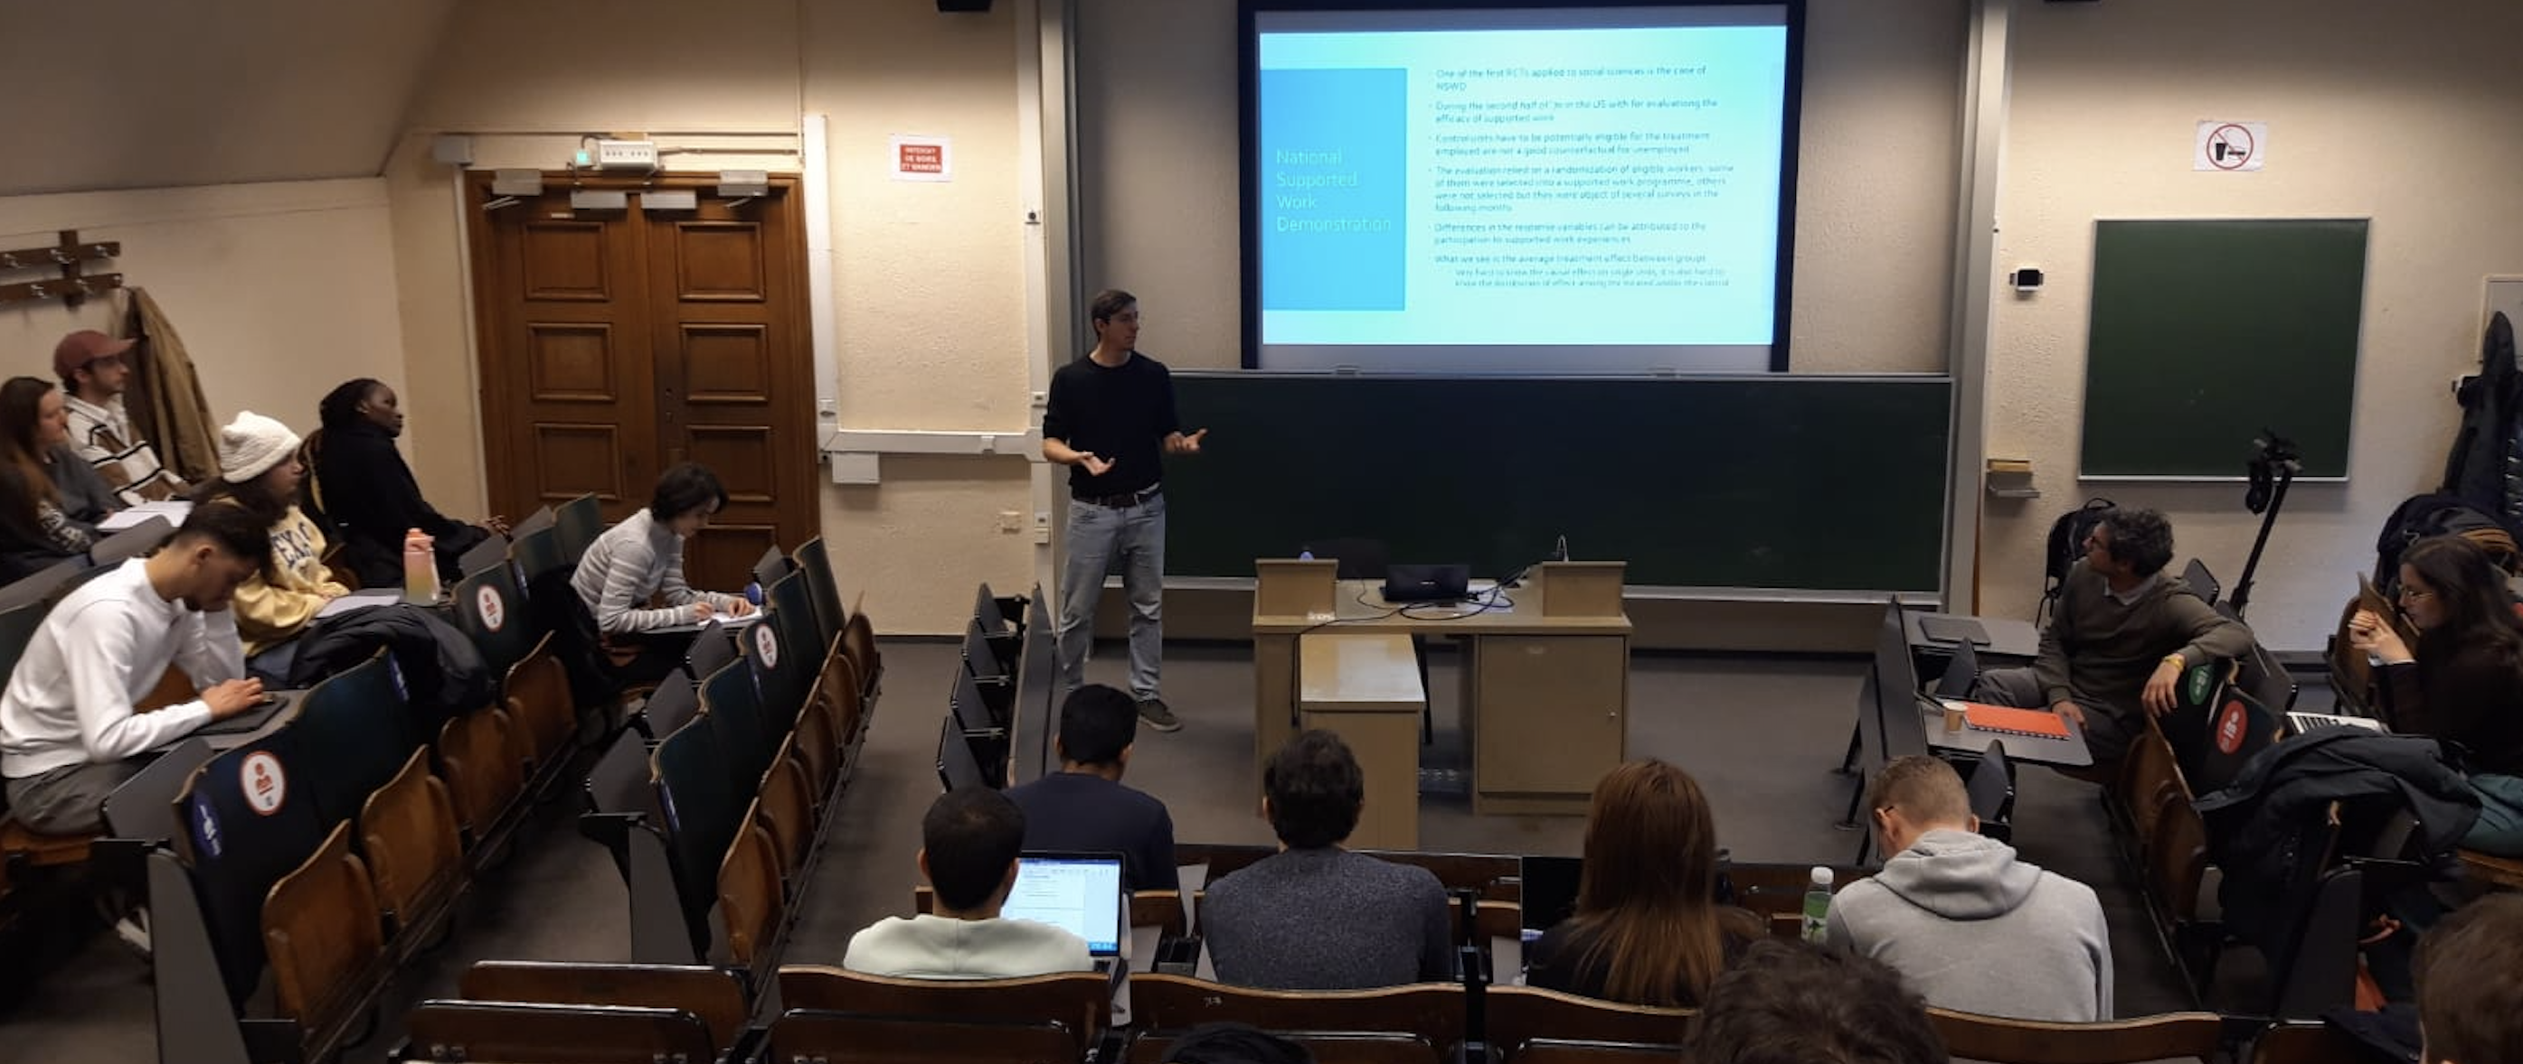
E-mail writing, sending and coding
Collective sessions for e-mail writing
Different languages and text content based on treatment
36 students divided in 4 groups to e-mails (a) to (d) whereas e-mails (e) administered by Transparencia.be
Coding
No reply
Denial
Unsatisfactory reply
Partial reply
Complete reply

Slide 18
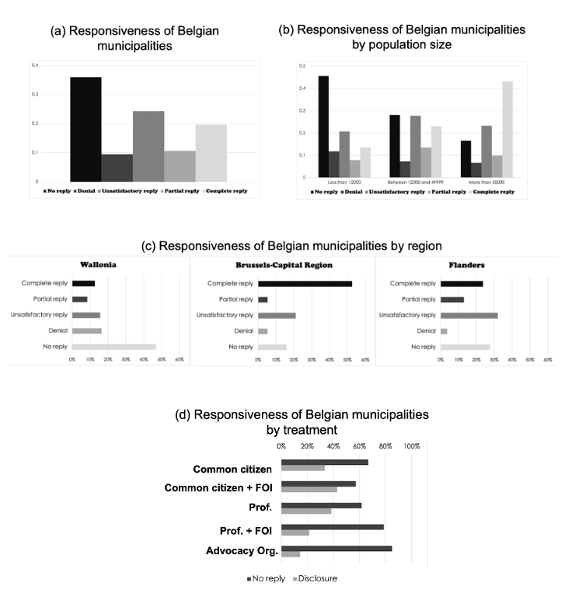
Results
36% of municipalities regadless of treatment did not respond whereas about 30% provided at least a partial reply
While almost 50% of small municipalities did not provide a reply, over 50% of large municipalities provided at least partial replies
H1 : Municipal size can impact response behaviors with larger municipalities being more responsive and likely to provide at least partial disclosure compared to smaller municipalities
Consistent with Wagner (2021) and Spáč et al. (2018)

Slide 19
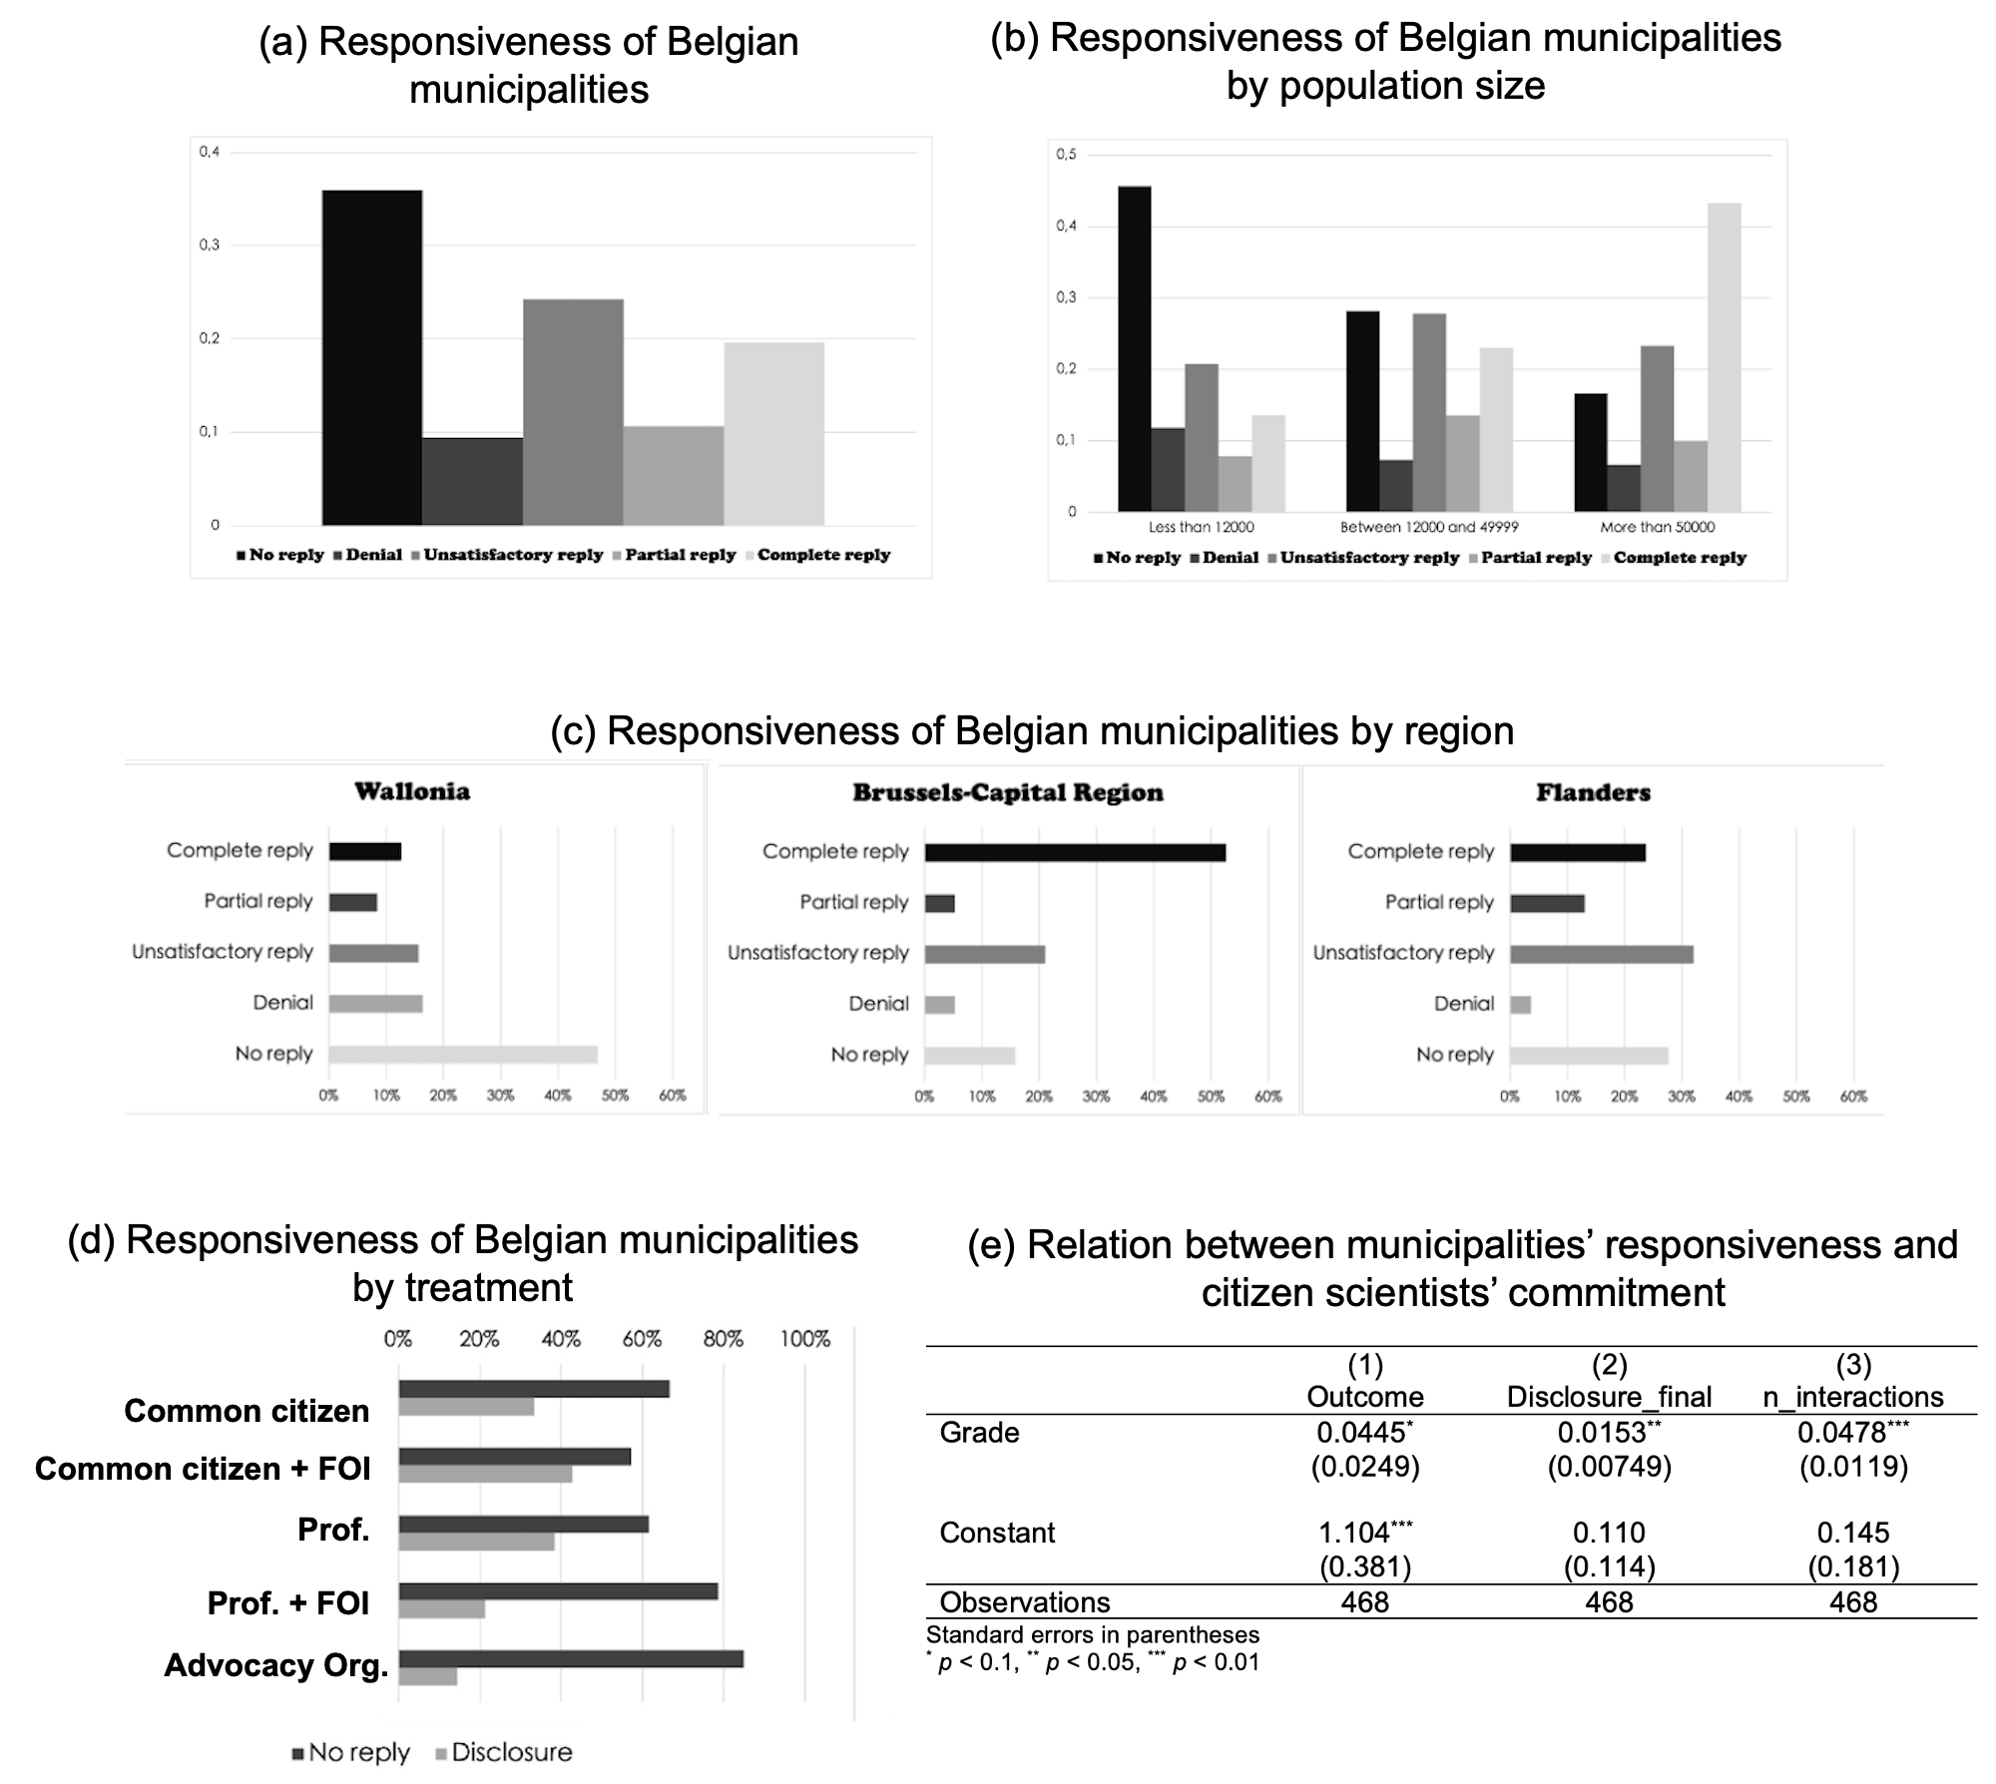

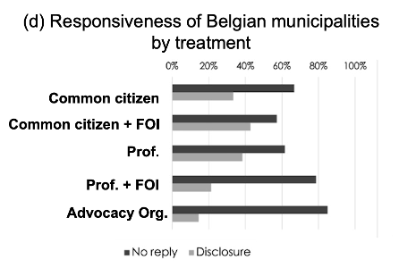
Results
Municipalities providing at least partial replies:
Brussels : 58%
Flanders : 46%
Wallonia : 21%
H2 : Regional contexts can impact response and disclosure rates
Consistent with Wagner (2021) and Cicatiello et al. (2024)

Slide 20
Results
Common citizens mentioning FOI have the highest disclosure rates whereas Prof. mentioning FOI and Advocay org. members have the highest no-reply rates
H3 : Municipalities have higher resistance to reply to FOI requests coming from individuals with greater knowledge
Inconsistent with Michener and Rodrigues (2015) but consistent with Cicatiello et al. (2024)

Slide 21
Key takeways : effectiveness of FOI implementation
FOI implementation in Belgium (~30%) shows moderate compliance
Comparable to Slovakia (29.5%), better than England (2%), but below Italy (59.6%)

Slide 22
Key takeways : effectiveness of FOI implementation
Request framing effect
Mentioning FOI boosts responsiveness for non-threatening requesters but reduces it when the requester is perceived as a threat
Requester identity effect
Municipalities are more reluctant to respond to requests from knowledgeable actors who may be perceived as a threat (e.g., professors, advocacy organizations or journalists)
H1
H2
FOI implementation in Belgium (~30%) shows moderate compliance
Comparable to Slovakia (29.5%), better than England (2%), but below Italy (59.6%)

Slide 23
Key takeways : effectiveness of FOI implementation
Request framing effect
Mentioning FOI boosts responsiveness for non-threatening requesters but reduces it when the requester is perceived as a threat
Requester identity effect
Municipalities are more reluctant to respond to requests from knowledgeable actors who may be perceived as a threat (e.g., professors, advocacy organizations or journalists)
H1
H2
FOI implementation in Belgium (~30%) shows moderate compliance
Comparable to Slovakia (29.5%), better than England (2%), but below Italy (59.6%)
Institutional effect
Responsiveness varies with socio-economic and political–administrative context
H3

Slide 24
Key takeways and future research
Request framing effect
Requester identity effect
H2
H1
Logit regressions as the dependent variable will have two options
Disclosure (1) or No disclosure (0)
Independent variables :
Experimental treatments
Contextual variables
Institutional effect
H3
Municipality size
Socio-economic profile (e.g.income, unemployment)
Political variables (mayor’s tenure, voter turnout, etc.)
Administrative jurisdictions

Slide 25
Next steps in TRANSACT
Replication plan
Switzerland
Romania
South Africa
Systematic extraction of data from Alaveteli platforms, using Transparencia.be as a case study
how the request’s topic, tone, and recipient authority influence the likelihood of receiving a reply versus refusal or silence

Slide 26
Thank you for your attention giovanni.esposito@ulb.be

Slide 27
Inferential statistics
Goal → To understand what factors influence whether a municipality discloses information (dependent variable)
Method → Logit regressions as the outcome has only two options
Disclosure (1) or No disclosure (0)
Independent variables :
Experimental treatments
Type of requester (Citizen, Professor, NGO)
Mention of FOI law or not Contextual factors
Contextual variables
Municipality size, income, unemployment
Political variables (mayor’s tenure, voter turnout, etc.)

Slide 28
Back up slides

Slide 29
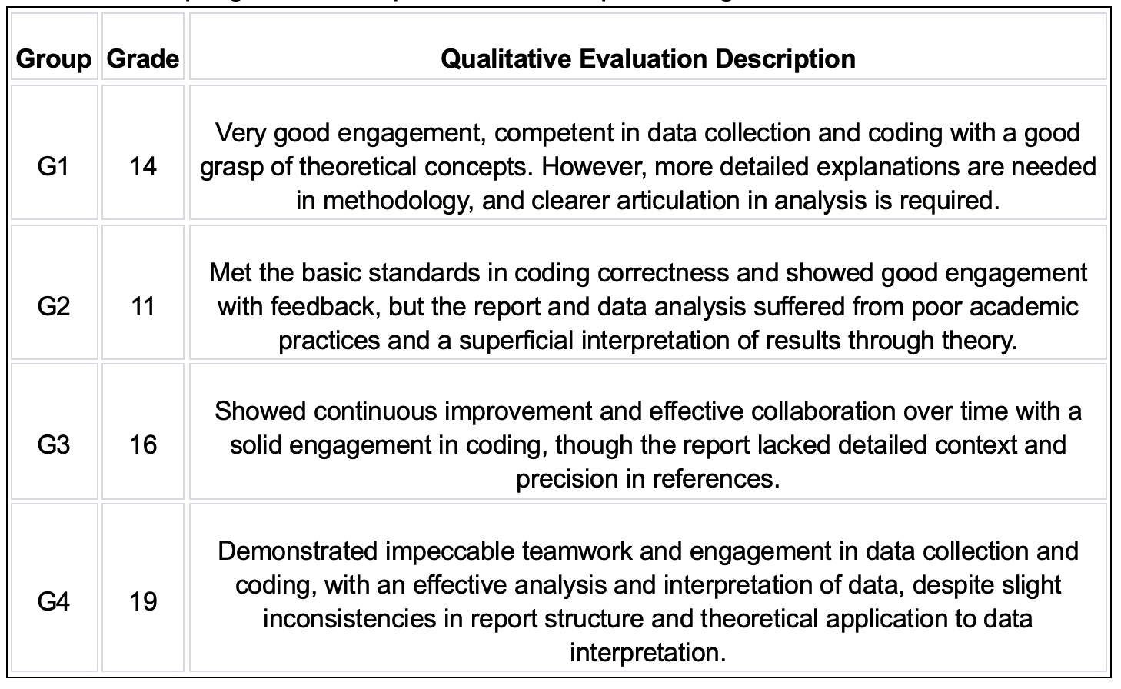
Participant observation
Professional researchers:
Particpation in weekly meetings and supervision of assigned group
Group work differences in terms of organizational patterns and performance
Detailed report for each group

Slide 30
Understanding municipal responses
Typology of Transparency | Definition | Example
Non-Transparency | The administration does not share information because no legal obligation exists. | A citizen requests access to financial accounts, but the municipality refuses, citing the absence of FOI laws. Information may be shared voluntarily but is not legally required.
Adverted Transparency | The administration intentionally hides information despite legal requirements. | A citizen requests environmental impact reports, but the municipality falsely claims the documents do not exist, deliberately concealing sensitive information.
Obstructed Transparency | The administration misuses legal exemptions to deny access to information. | A journalist requests contracts between a municipality and a private company. The administration denies access, citing confidentiality or national security, even though these exemptions are not valid in this case.
Strained Transparency | The administration wants to comply but lacks the resources to provide a complete response. | A citizen requests budgets from the past five years. The municipality replies it cannot process the request due to staff shortages or provides poorly scanned, unreadable documents.
Insufficient Transparency | The information provided is incomplete or partial. | A citizen requests council meeting minutes and annexes. The municipality provides only the minutes and directs the citizen to a website with limited information, omitting key annexes.
Maximized Transparency | The administration fully complies with legal requirements, providing all requested information transparently. | A citizen requests documents on waste management decisions. The municipality promptly provides all requested documents and publishes them online for public access, ensuring full compliance with FOI laws.

Slide 31
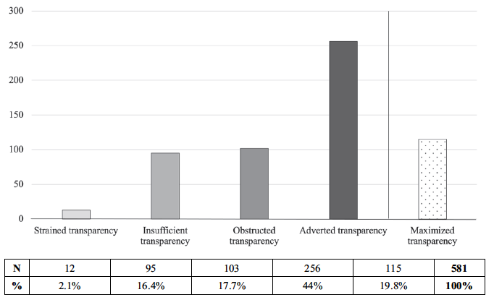
Understanding municipal responses
Belgian administration officials intentionally hides information despite legal requirements

Slide 32
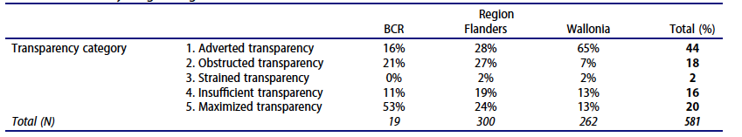
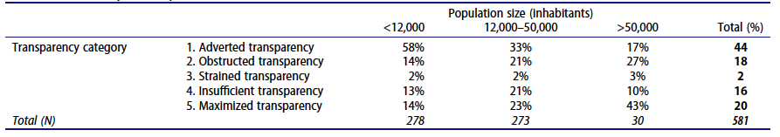
Understanding municipal responses

Slide 33
From managing complexity to transparency
2014
Megaproject governance
2019
Urban development policies
2022
Implementation of FOI laws in Belgium
TRANSACT
The implementation gap
Discretion and structural barriers
Wicked problems and multi-actor cooperation
Transparent information exchange
Cost overruns, delays, and local opposition
Risks of secrecy and lack of transparency
Notes:
Urban development challenges are wicked problems involving multiple actors with divergent interests and logics of action. Effective cooperation is only possible when information is shared adequately and transparently

Slide 34
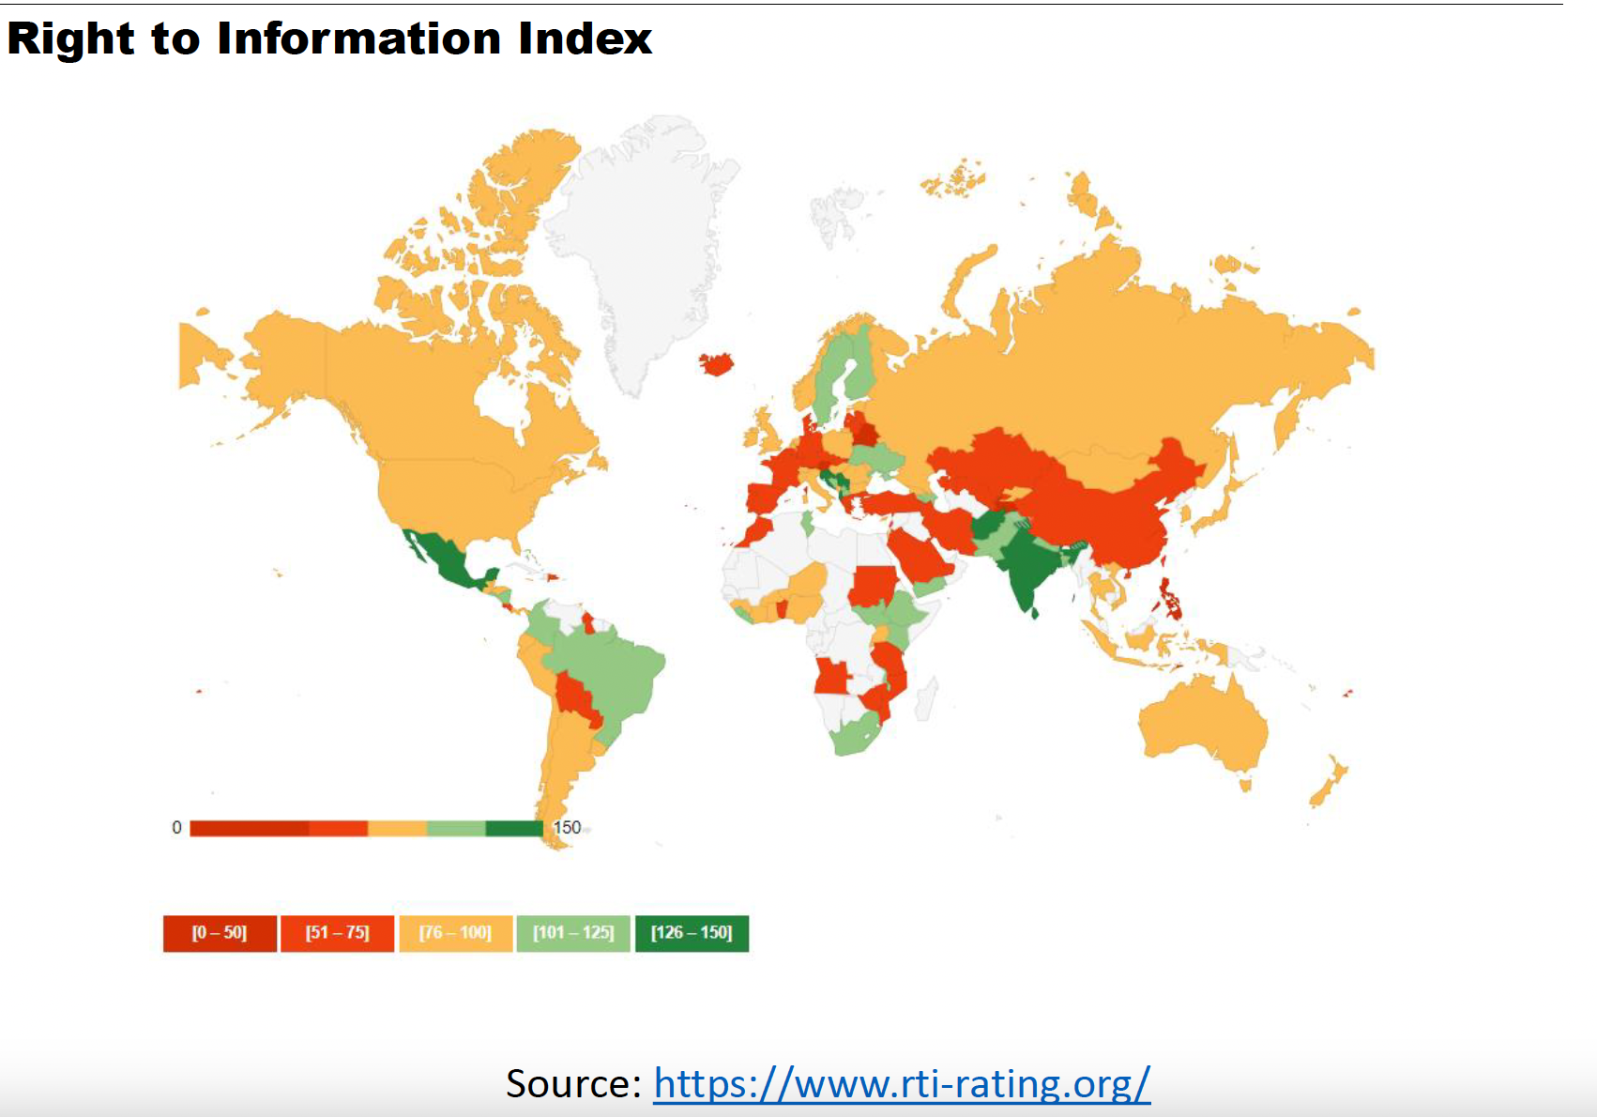
RTI index

Slide 35
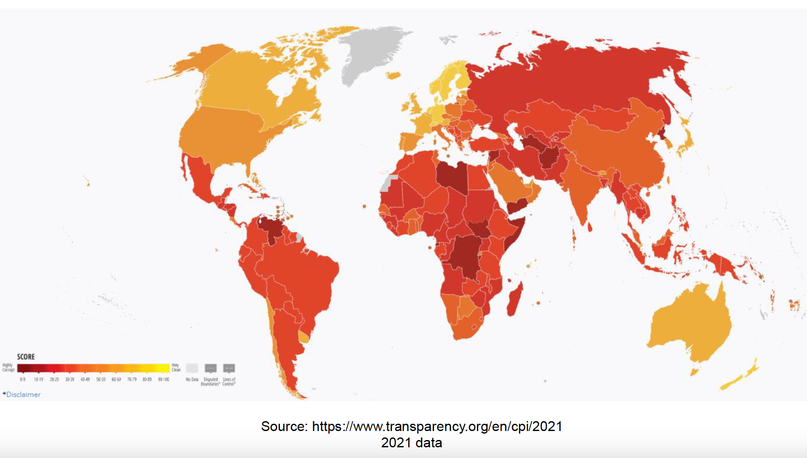
Corruption Perception Index

Slide 36
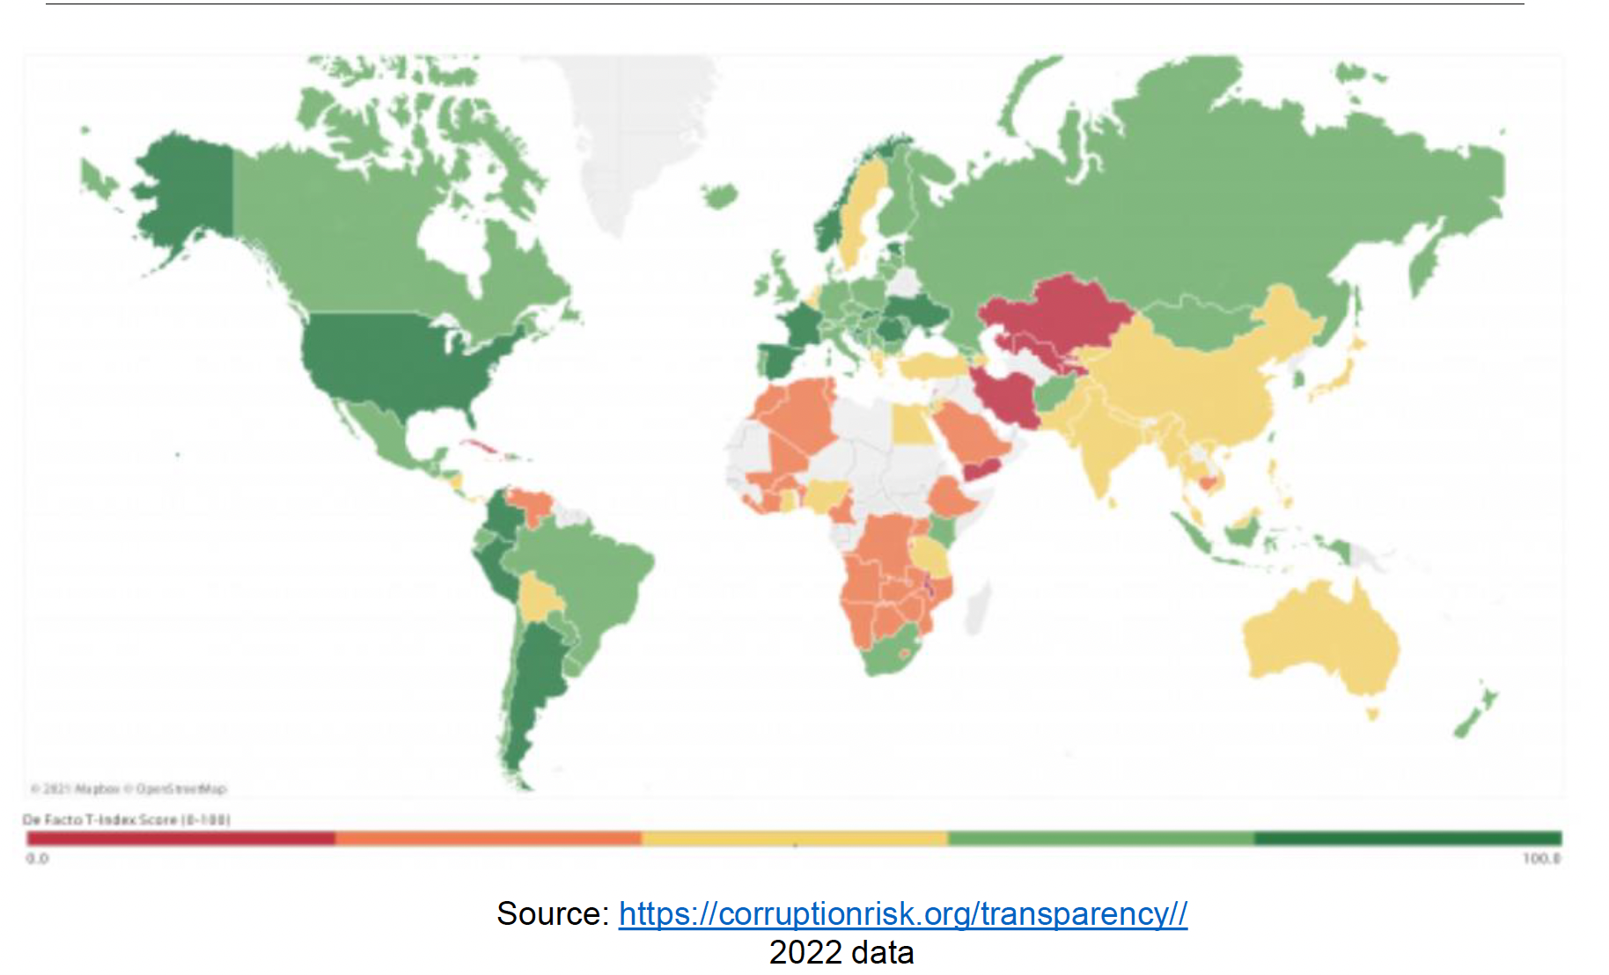
Transparency Index

Slide 37
Transparency measures
TRANSPARENCY MEASURE | DESCRIPTION | TOP 5 COUNTRIES
Global Right to Information Rating (RTI Rating) | This index measures the strength of legal frameworks for the right to information across the world. | Afghanistan Mexico Serbia Sri Lanka Slovenia
Corruption Perceptions Index (CPI) | Created by Transparency International, the CPI assesses public sector corruption perceptions across the world. It aggregates data from a variety of sources reflecting the opinions of experts and businesspeople on the level of corruption in a country. | Denmark Finland New Zealand Norway Singapore
Government Transparency Index (T-Index) | Developed by The European Research Centre for Anticorruption and State-building (ERCAS), the T-Index assesses government transparency based on various transparency services, encompassing both de jure (legal commitments) and de facto (actual practices) aspects of transparency. It measures computer-mediated transparency, representing the availability of public data. | Slovak Republic France Estonia Croatia Lithuania

